Slide 1
HMH Science Dimensions
Biology
Unit 3 Matter and Energy in Living Systems
Notes:
The learning experiences in this unit prepare students for the mastery of
Performance Expectations
LS1-5 Use a model to illustrate how photosynthesis transforms light energy into stored chemical energy.
LS1-7 Use a model to illustrate that cellular respiration is a chemical process whereby the bonds of food molecules and oxygen molecules are broken and the bonds in new compounds are formed, resulting in a net transfer of energy.
LS2-3 Construct and revise an explanation based on evidence for the cycling of matter and flow of energy in aerobic and anaerobic conditions.
LS2-4 Use mathematical representations to support claims for the cycling of matter and flow of energy among organisms in an ecosystem.
LS2-5 Develop a model to illustrate the role of photosynthesis and cellular respiration in the cycling of carbon among the biosphere, atmosphere, hydrosphere, and geosphere.

Slide 2

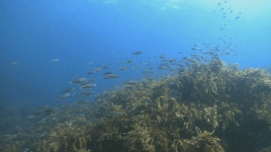
Matter and Energy in Living Systems
Unit 3
Kelp forests are important aquatic ecosystems.

Slide 3

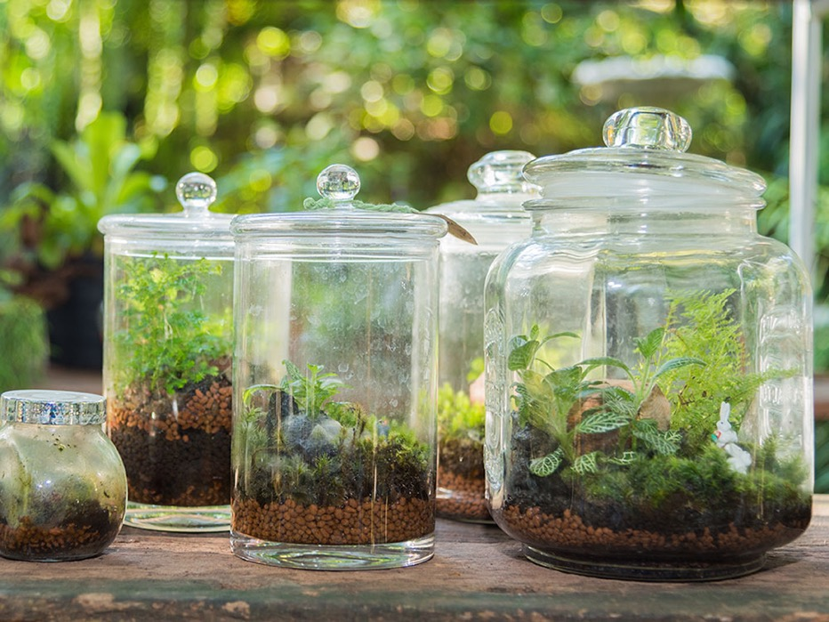

Living Systems
Unit 3
How do you think plants and animals grow if no new matter is added to the system?
These terrariums are self-sustaining environments.

Slide 4
Driving Questions
Unit 3
As you move through the unit, gather evidence to help you answer the following questions:
What do plants need to survive? How do plants obtain energy?
How do animals obtain energy to grow?
How are energy and matter transferred through organisms and their environment?

Slide 5

Unit Project
Unit 3
Bottle Biome
How do energy and matter cycle through a closed system such as the Earth system? How do the plants and animals survive? Make your own closed biological system inside a bottle, and investigate how the plants and animals survive with no materials being added to the system. Can you explain how the bottle represents Earth?

Slide 6
Unit Review
Unit 3
Synthesize the Unit
Make a concept map, other graphic organizer, or outline using the Study Guides you made for each lesson in this unit. Be sure to use evidence to support your claims.
When synthesizing individual information, remember to follow these general steps:
Find the central idea of each piece of information.
Think about the relationships among the central ideas.
Combine the ideas to come up with a new understanding.

Slide 7
Image Credits
Unit 3
fish in kelp forest video ©WOWstockfootage/Iconica Video/Getty Images; terrarium ©HMH

